Slide 1
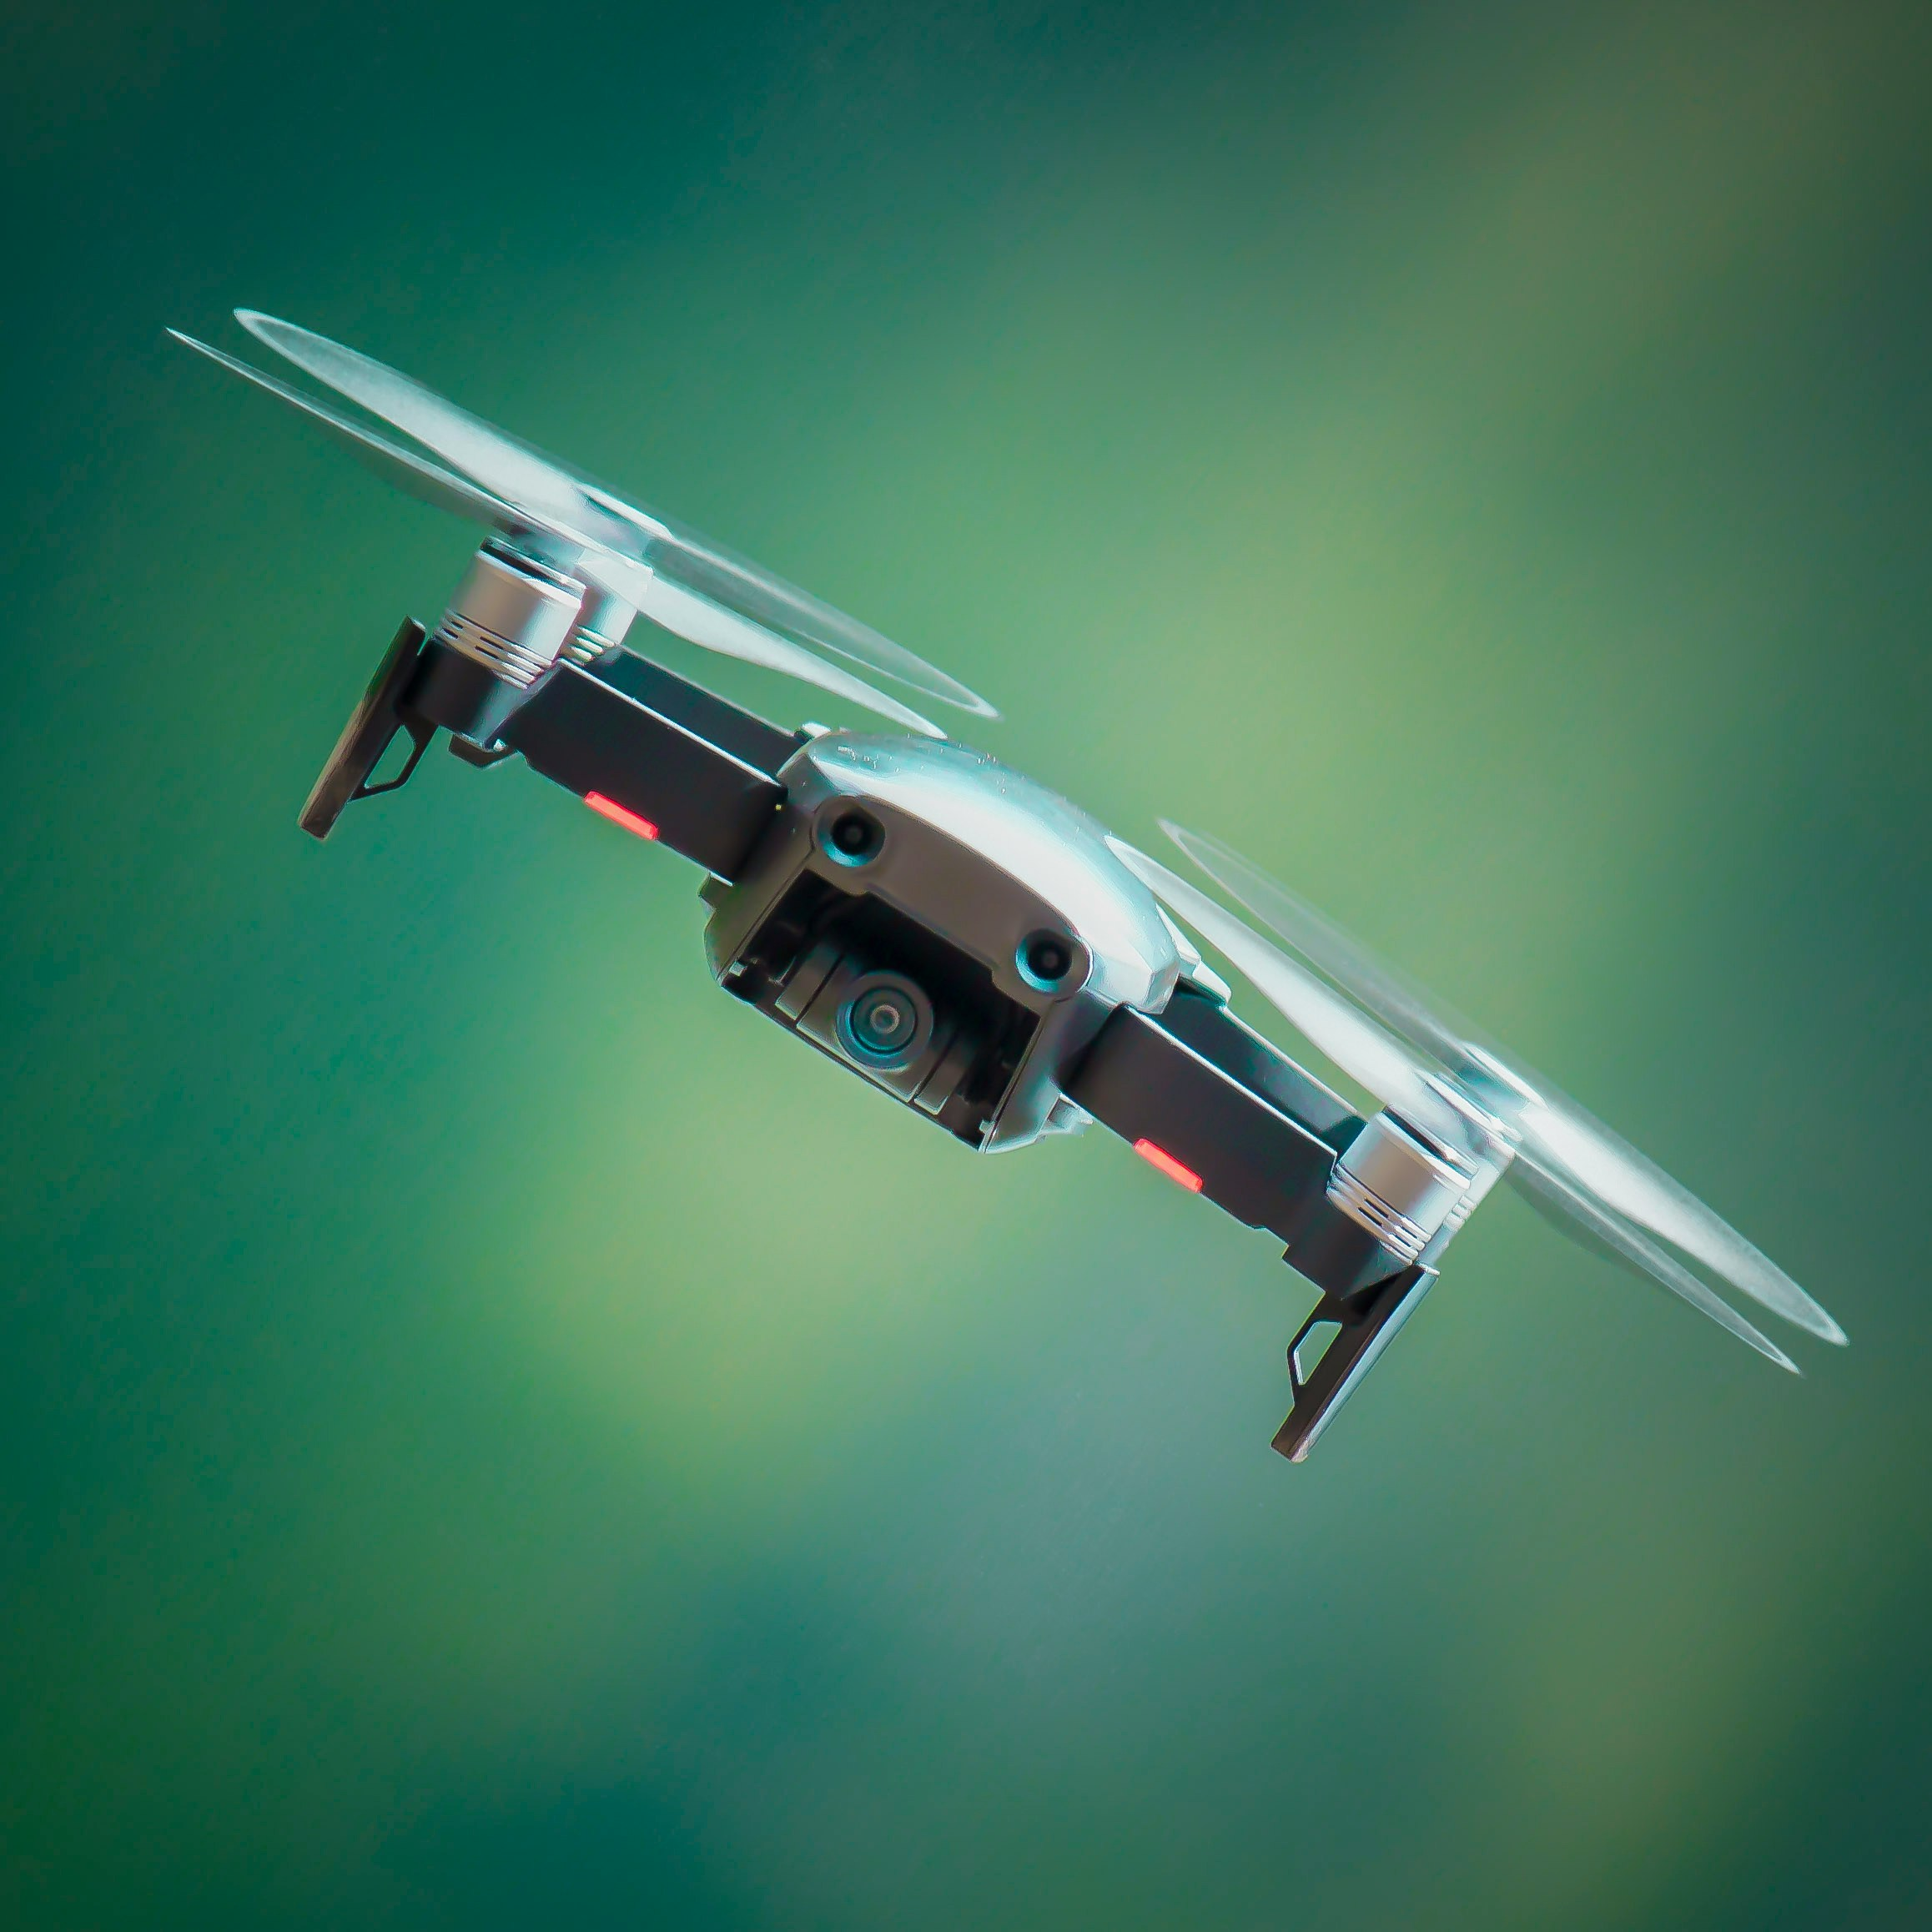
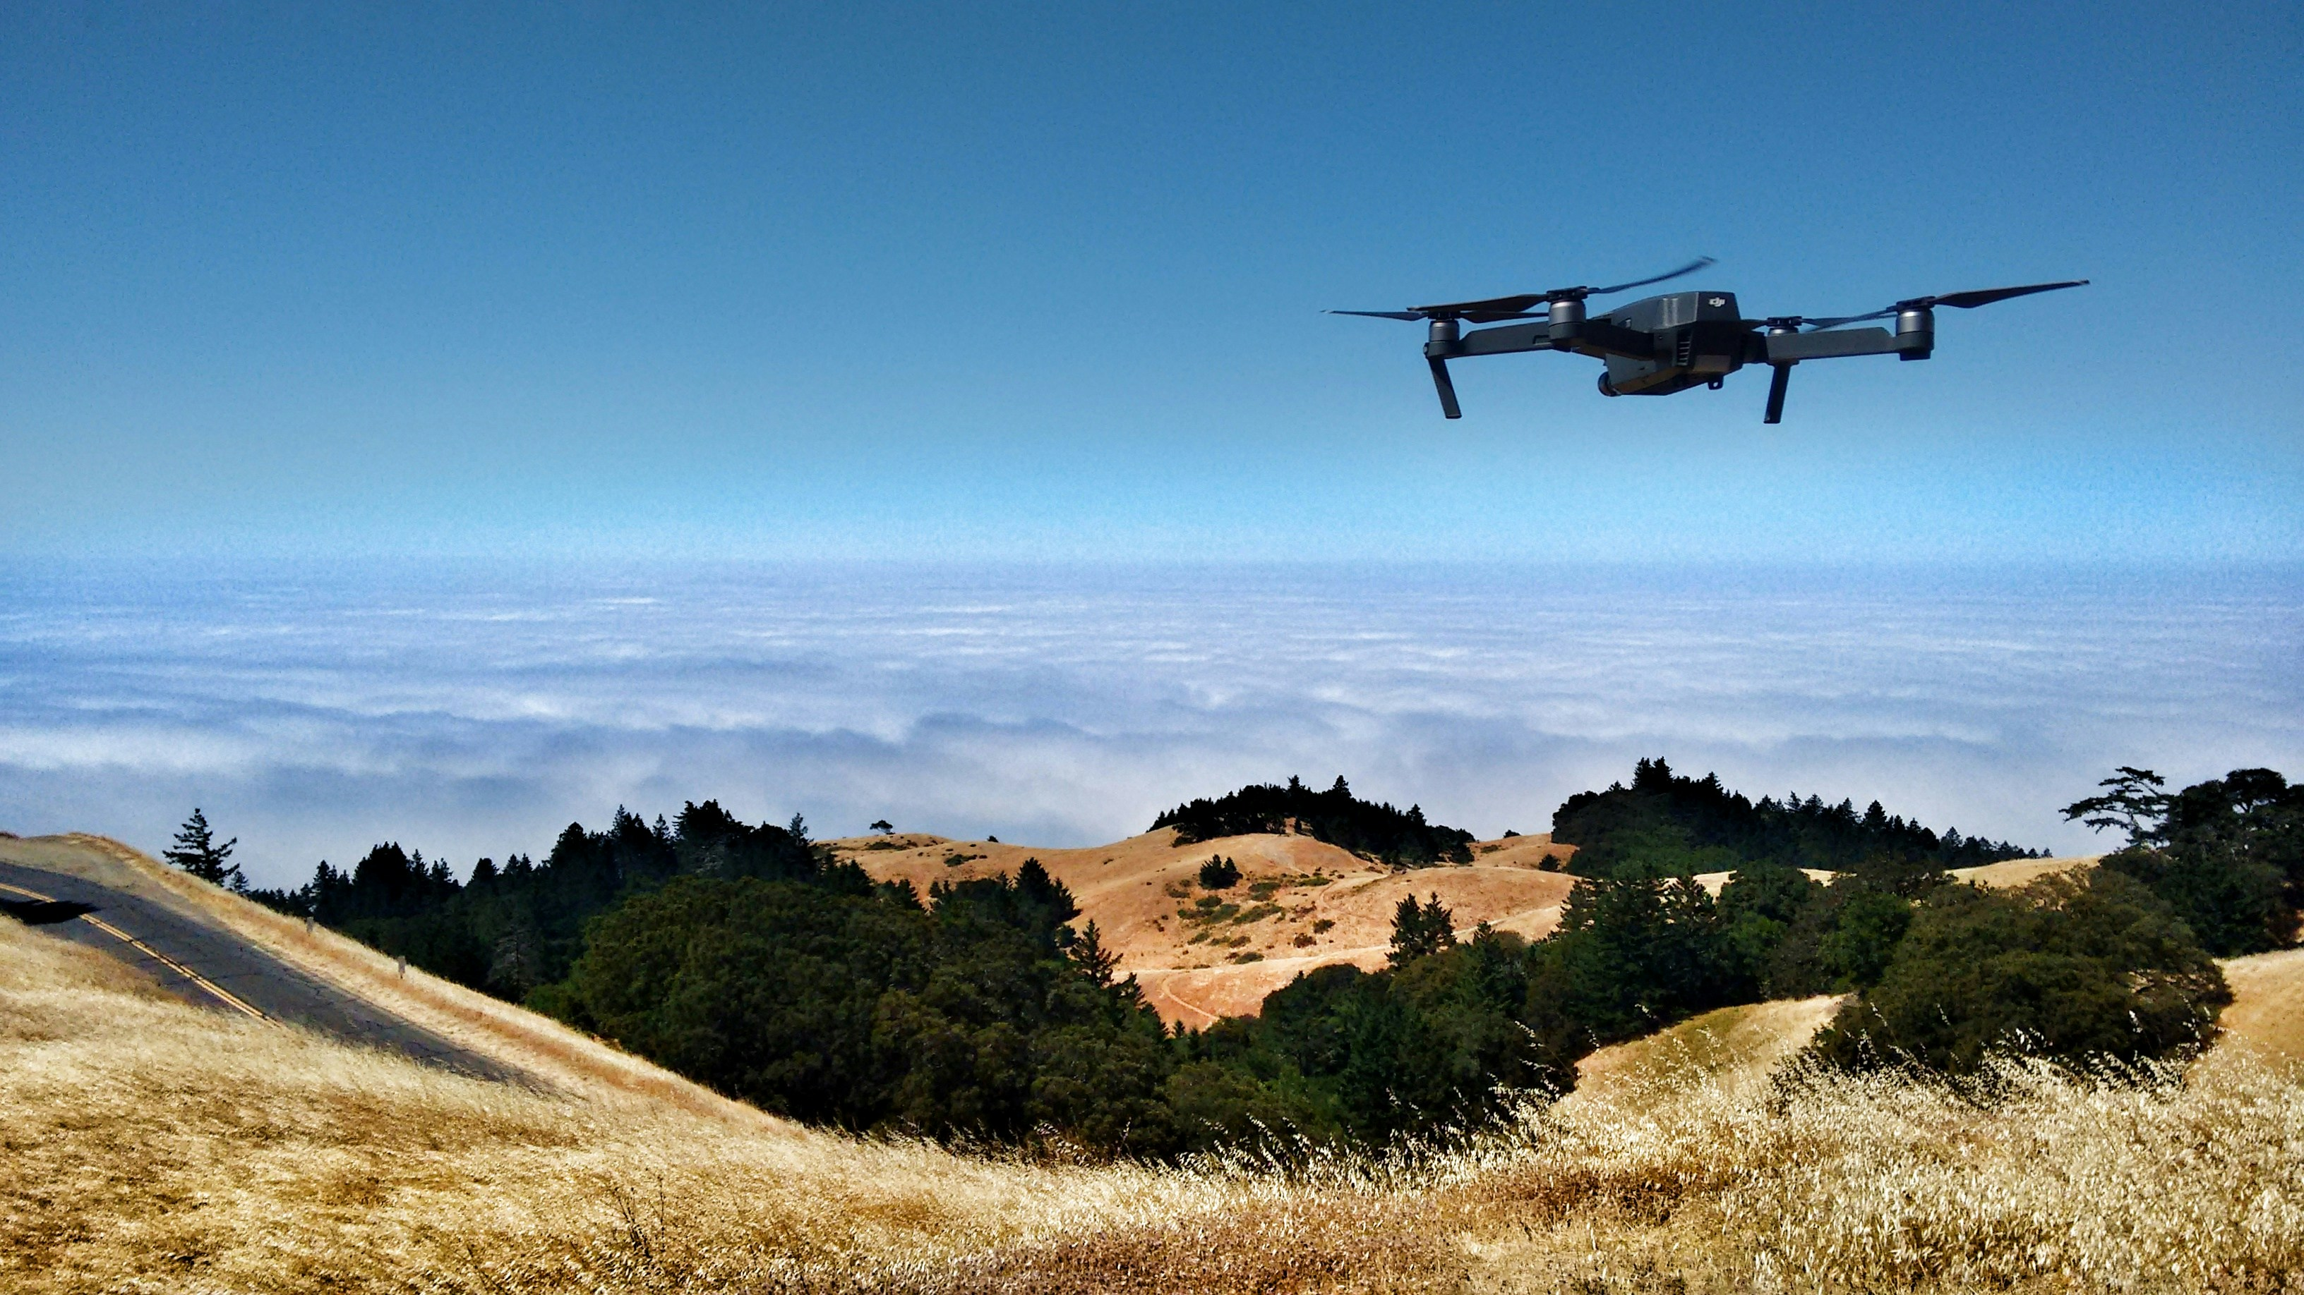
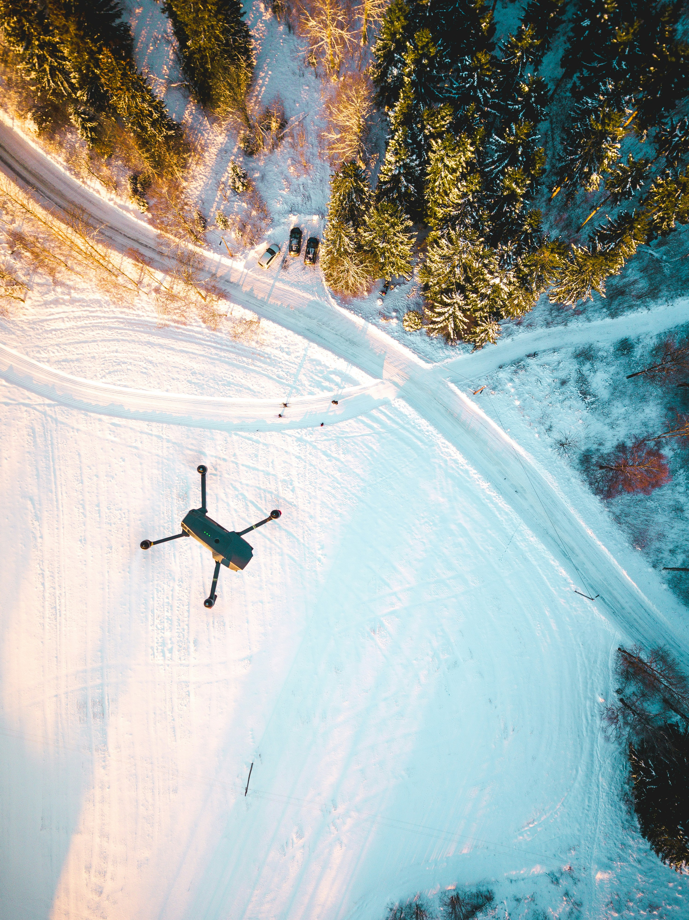
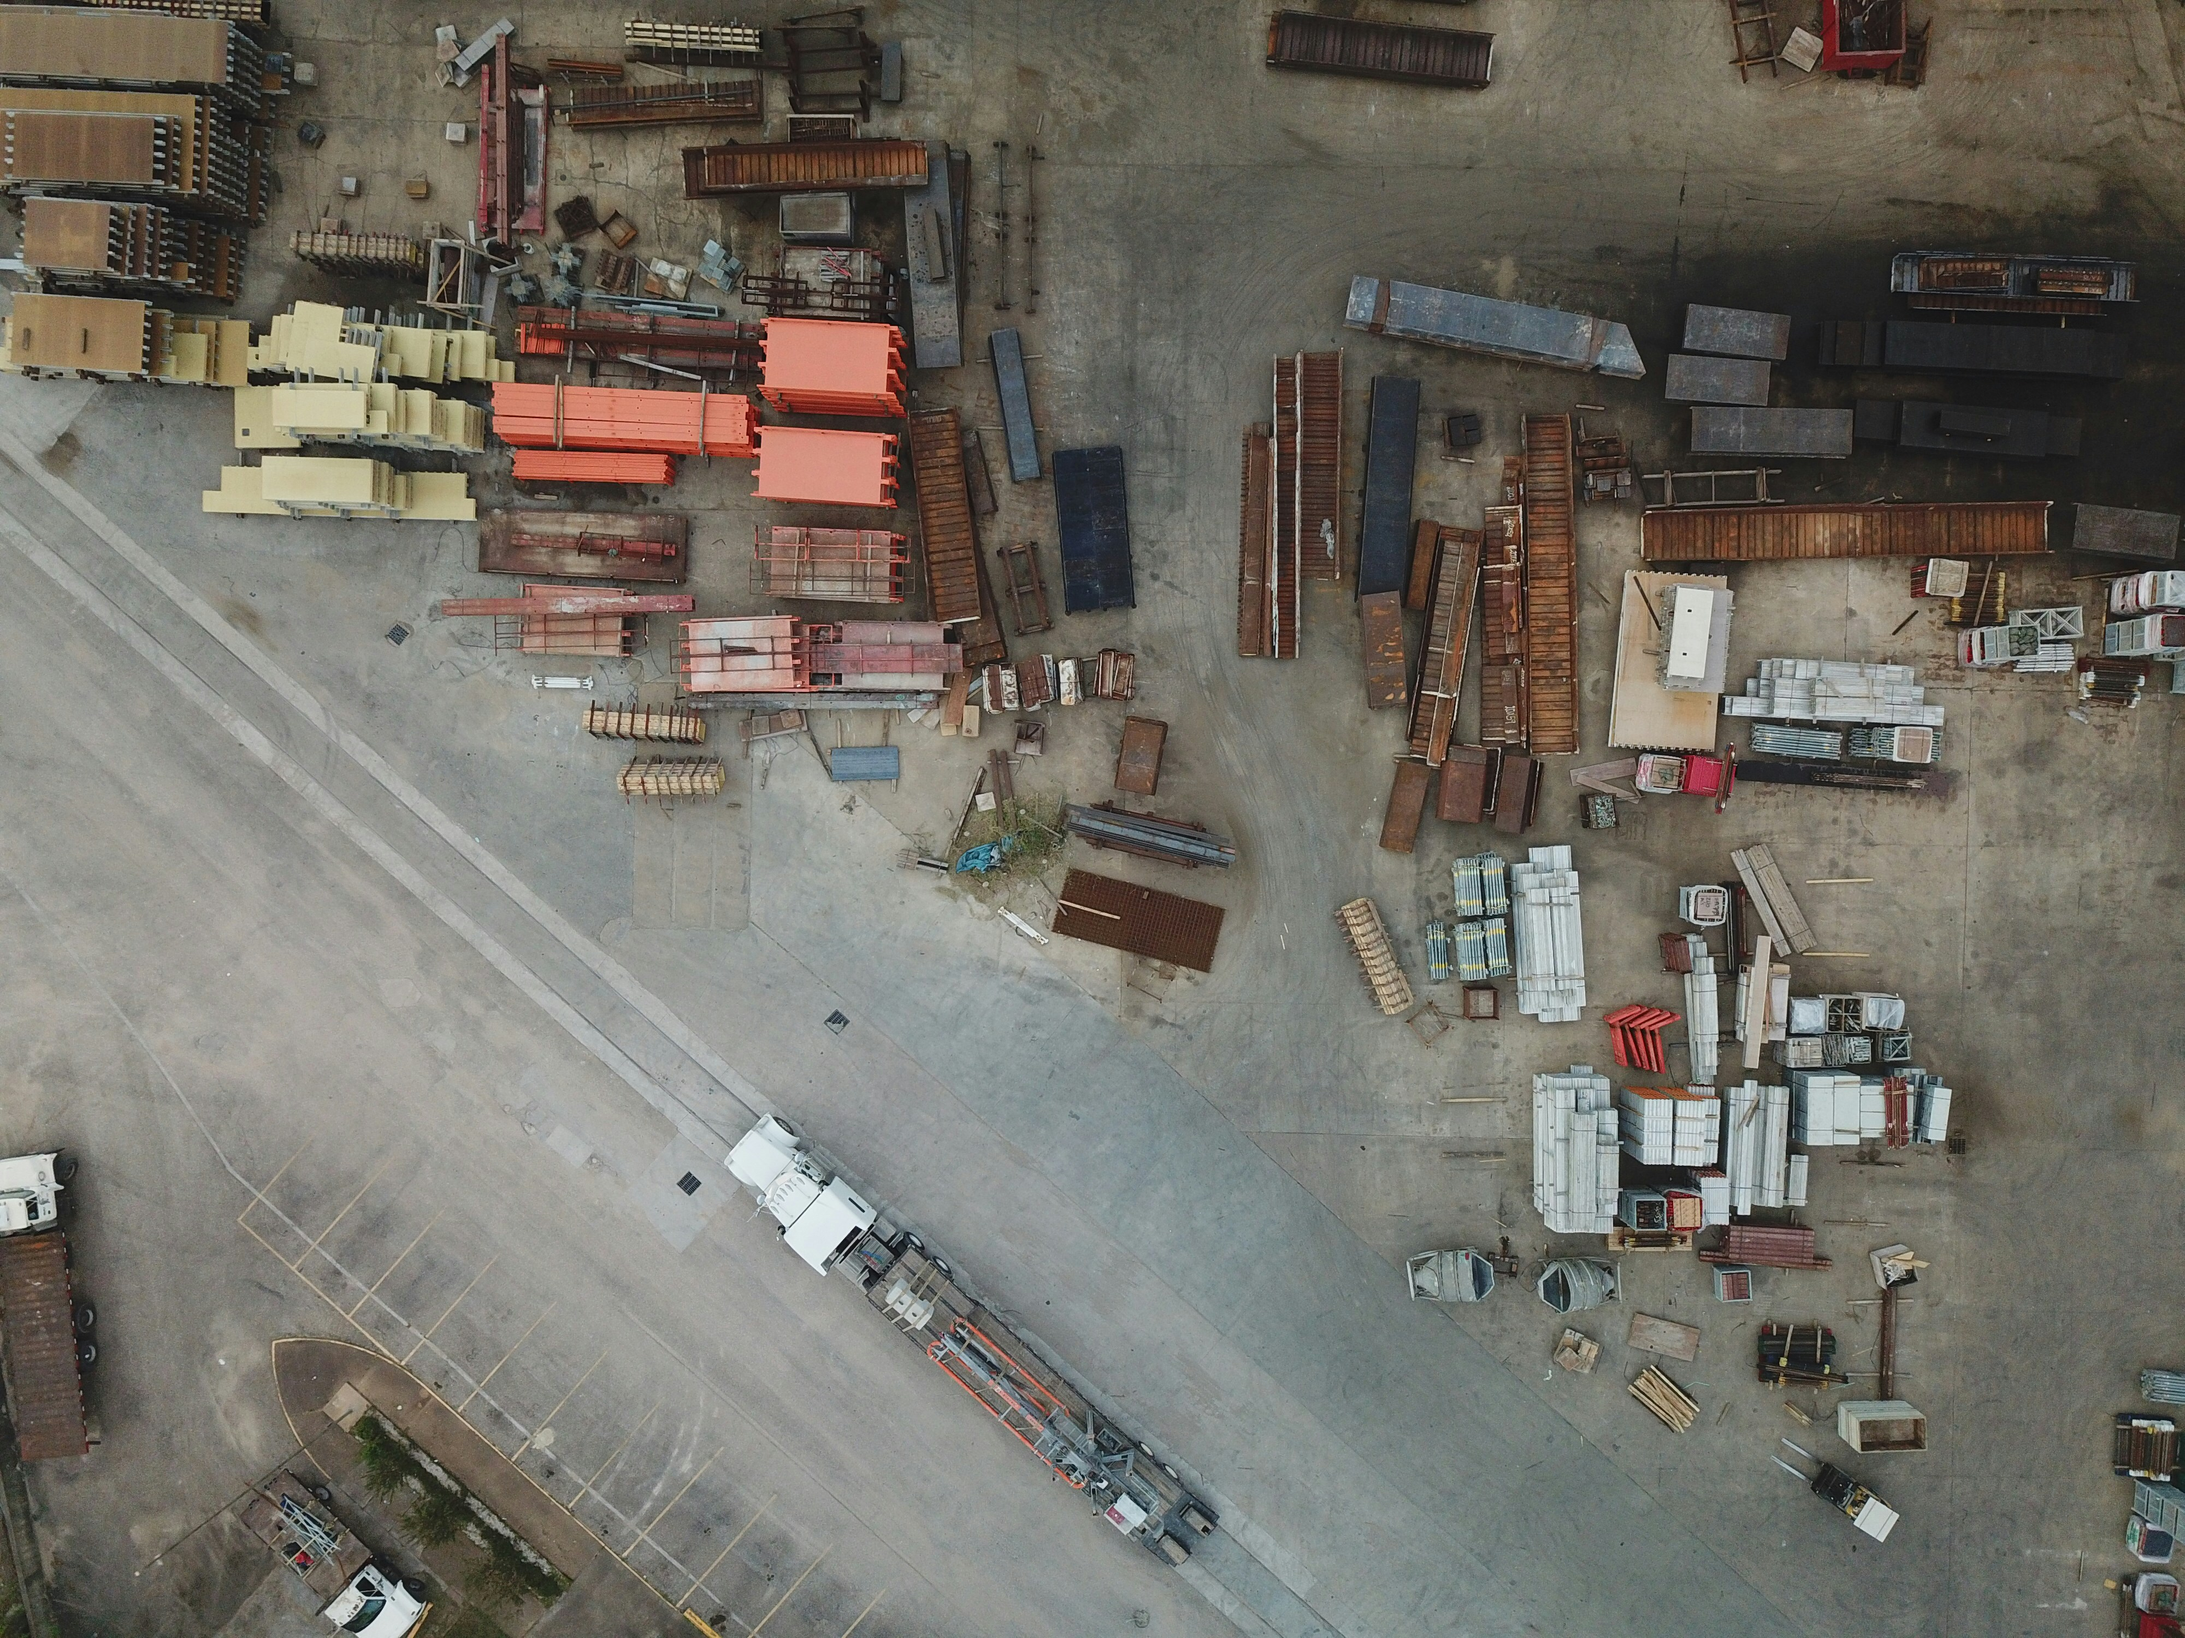

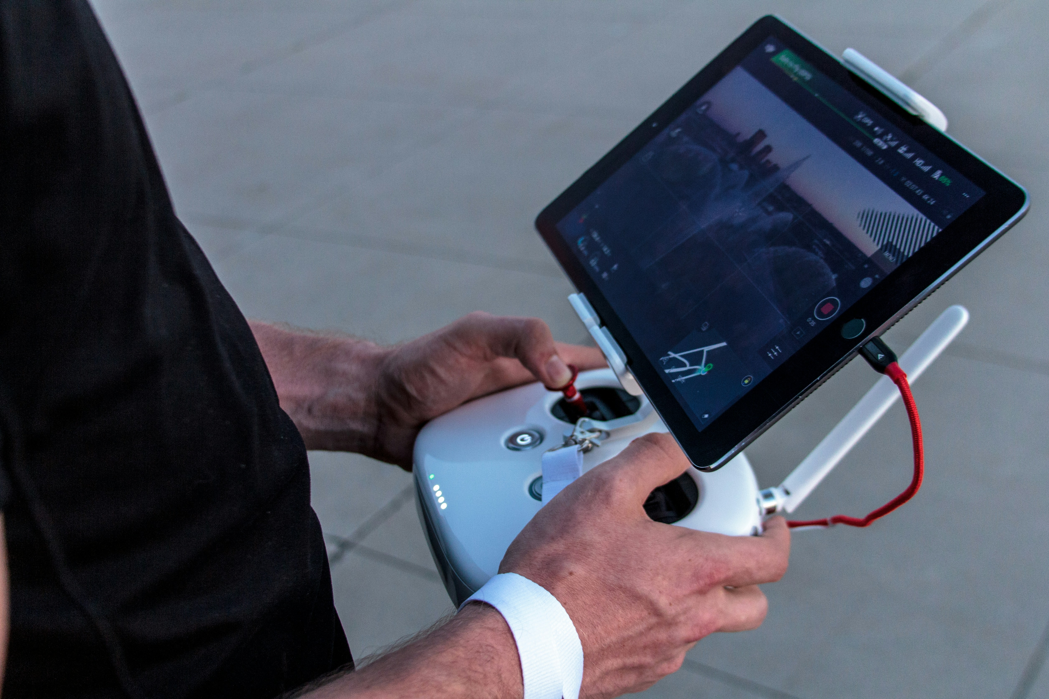
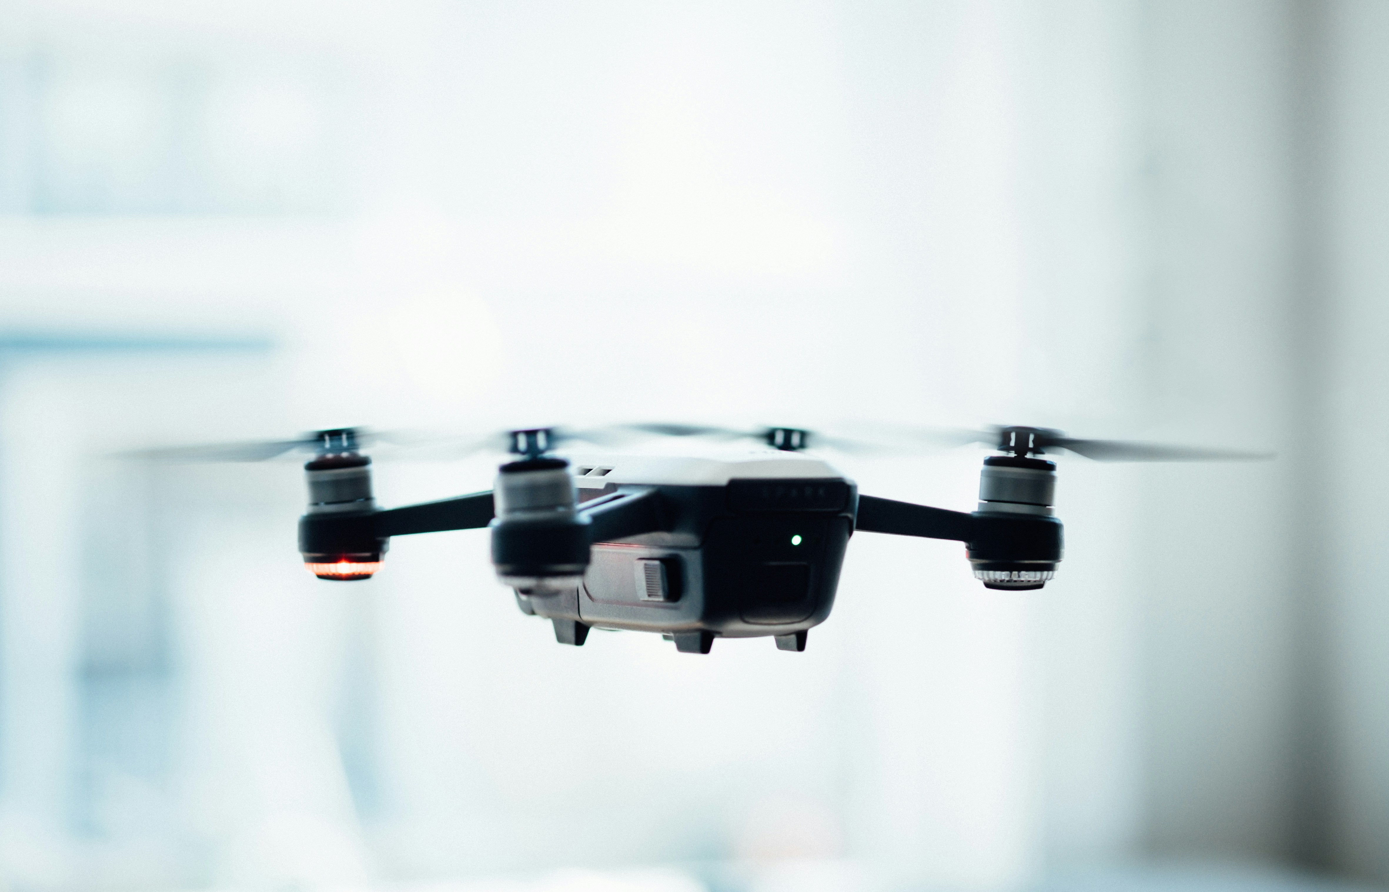
SkySight

Slide 2
Case Study
VisDrone-DET2018: The Vision Meets Drone Object Detection in Image Challenge Results
Objective:
Narrow the gap between current object detection performance and real-world requirements on drone platforms.
Organize a large-scale object detection challenge.
Release a comprehensive drone-based dataset.
Real-Time Impact:
Enhanced Robustness: Improvements in detection algorithms enhance their robustness in real-time applications.
Practical Applications: Results applicable in video surveillance, autonomous driving, and image understanding.
Algorithm Development: Encourages advancements in real-time drone-based detection systems.
SkySight

Slide 3
Introduction
Tasks at a Glance
Object Detection: Pinpointing objects with precision.
Object Tracking: Following objects through dynamic scenes.
Crowd Counting: Accurately estimating crowd sizes.
Semantic Segmentation: Classifying each pixel for detailed scene understanding.
The Ultimate Dataset
Expansive and Diverse: Encompassing urban jungles to serene rural landscapes.
Rich Annotations: Detailed labelling of pedestrians, vehicles, and more.
Tackling the Toughest Challenges
Scale Variability: Objects seen from varying distances.
Occlusion: Handling hidden and partially visible objects.
Background Diversity: Navigating complex and varied environments.
Lighting Variations: Adapting to different illumination conditions.
SkySight

Slide 4
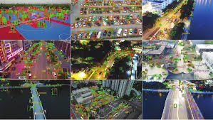
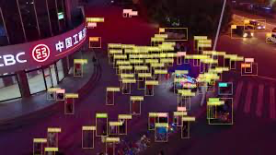
Objective
Real-World Impact
Public Safety: Improve surveillance and emergency response.
Traffic Management: Monitor and reduce congestion and accidents.
Disaster Response: Enable rapid assessment and resource allocation.
Environmental Monitoring: Track changes and monitor wildlife.
Urban Planning: Assist in development and infrastructure maintenance.
Research Advancement: Push AI and computer vision boundaries.
SkySight

Slide 5
Role of Machine Learning
Integration:
Data Processing: Convert drone data into actionable insights.
Automation: Minimize human intervention with automated decisions.
Adaptability: Models adapt to new data for continuous improvement.
Key Capabilities:
Object Detection: Real-time identification with CNNs (YOLO, SSD).
Anomaly Detection: Find unusual patterns with clustering, PCA.
Predictive Analytics: Forecast events with time series analysis.
Semantic Segmentation: Label each pixel for detailed scene analysis.
Crowd Counting: Estimate crowd sizes for public safety.
Multi-Object Tracking: Track multiple objects across frames.
SkySight

Slide 6
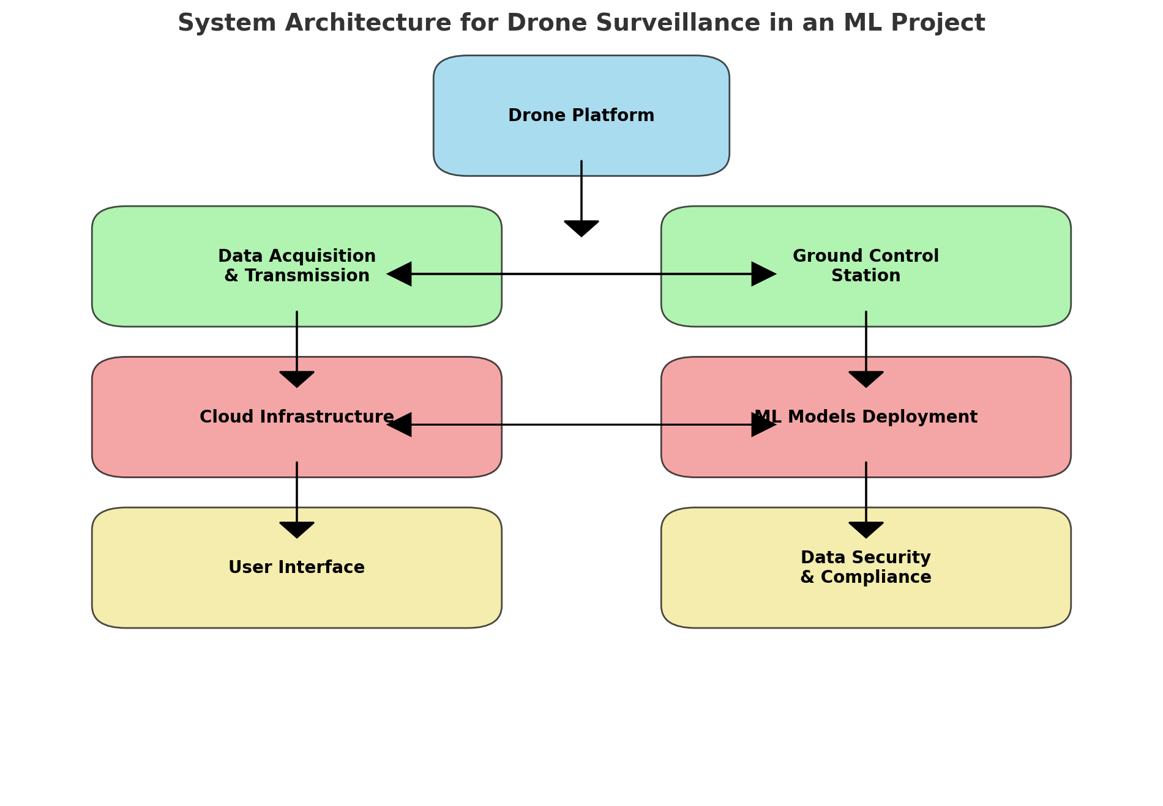
System Architecture For Drone Surveillance
SkySight

Slide 7
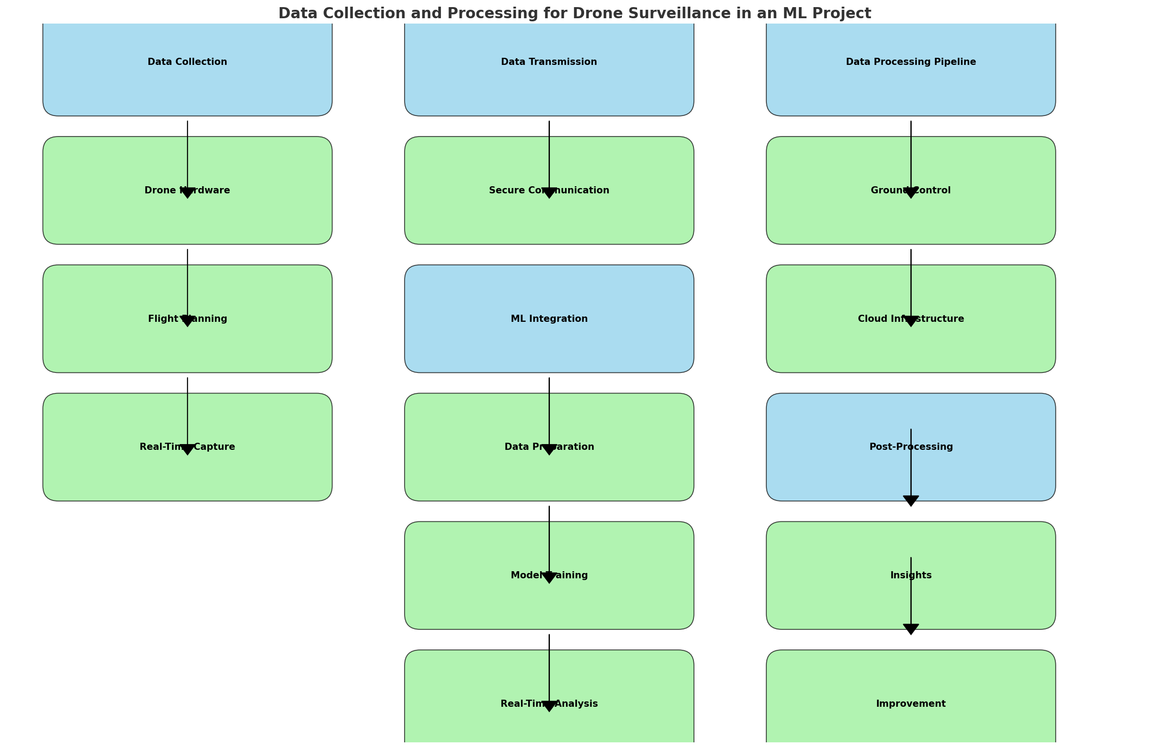
Data Collection and Processing
SkySight

Slide 8
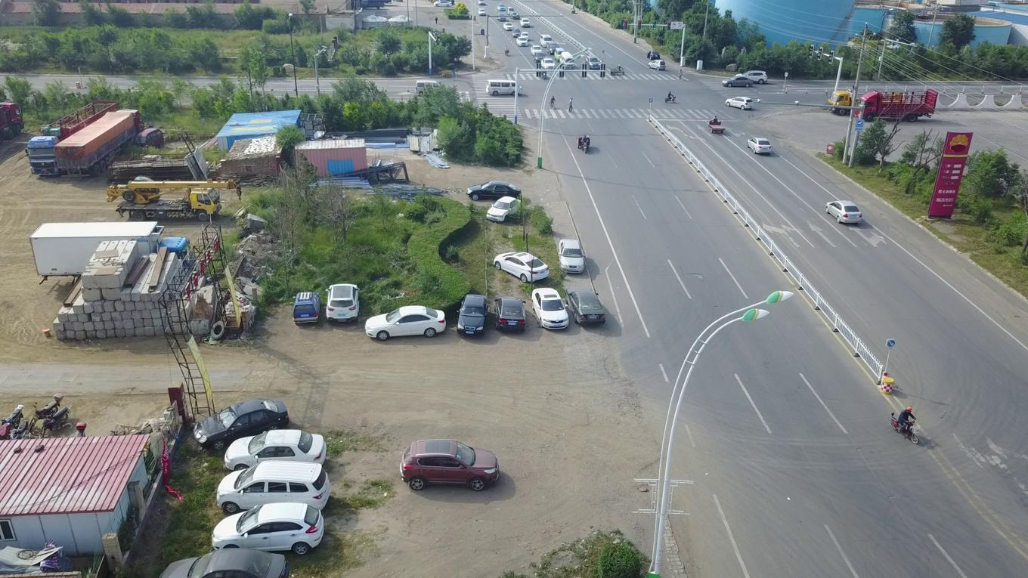
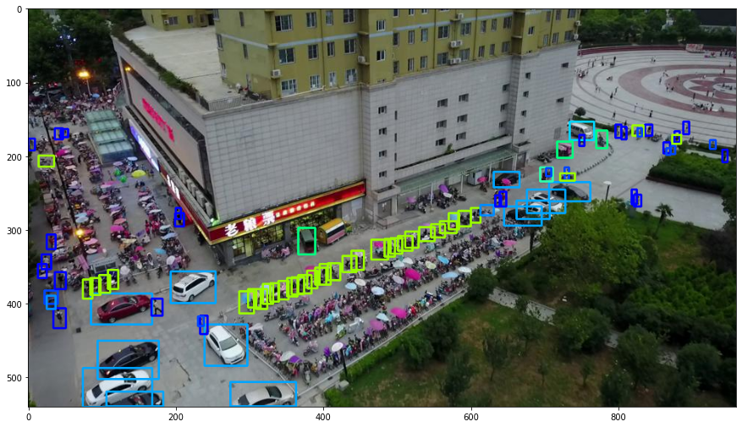
Dataset:
Total Images: 2590
Training: 1942
Validation: 165
Testing: 483
Annotations: Object bounding boxes, categories, occlusion, truncation ratios.
Scenarios: Diverse real-world scenarios across different cities.
Categories: 10 predefined categories (e.g., pedestrian, car, bus).
SkySight

Slide 9
Benefits, Challenges and Solutions
Benefits:
Innovation Stimulation: Promotes development of new object detection techniques.
Benchmarking: Provides a standard benchmark for evaluating object detection algorithms.
Collaboration: Facilitates collaboration among researchers and institutions globally.
Real-World Application: Results can be directly applied to enhance real-time drone-based systems.
Challenges:
Large Scale Variations: Substantial differences in object scales within the same category.
Occlusion: Significant impact on detection performance due to object occlusion.
Class Imbalance: Imbalance in the frequency of different object categories affecting accuracy.
SkySight

Slide 10
Benefits, Challenges and Solutions
Solutions:
Scale Variations:
Redesign anchor scales to adapt to object scales.
Fuse multi-level convolutional features for better contextual information.
Implement multi-scale testing and model ensemble techniques.
Occlusion:
Develop occlusion handling strategies to improve detection accuracy.
Data Augmentation and Sampling:
Apply data augmentation techniques to balance the dataset artificially.
Use sampling strategies to ensure that underrepresented classes are adequately represented during training.
Model Optimization:
Optimize algorithms for efficient processing to meet real-time requirements.
Utilize hardware accelerations like GPUs to reduce latency and improve frame rates.
SkySight

Slide 11
Reference:
Dataset: Visdrone
Papers:
Zhu, P., Wen, L., Du, D., Bian, X., Ling, H., Hu, Q., ... & Song, Z. (2018). VisDrone-DET2018: The Vision Meets Drone Object Detection in Image Challenge Results. In Proceedings of the European Conference on Computer Vision (ECCV) Workshops. https://openaccess.thecvf.com/content_eccv_2018_workshops/w27/html/Zhu_VisDrone-DET2018_The_Vision_Meets_Drone_Object_Detection_in_Image_Challenge_ECCVW_2018_paper.html
SkySight

Slide 12
Q&A

Slide 13
SkySight

